Slide 1
Remove from 2nd floor storage area in parking structure and into elevator. Unit is on rolling dolly.

Slide 2
Move into elevator from 2nd floor parking structure lot.

Slide 3
Move to appropriate area to set up.

Slide 4
Remove white pole lifts and remove exterior wrap.

Slide 5
Remove first tarp (bottom of tent). Unfold and place on ground lengthwise with black velcro at each end.

Slide 6
With floor tarp in place, move tent into center of bottom tarp.

Slide 7
Rotate tent so fluorescent tabs line up with entrance/exit door openings.

Slide 8
Unloosen belly strap.

Slide 9
Loosen yellow belly strap and pull corners to four corners of tarp.

Slide 10
Gently take the curtains and drape over the sides of the tent. Note yellow fluorescent marker that is at top of center opening.

Slide 11
Red strap indicates clip for corner. Align corners to prepare to raise tent.

Slide 12
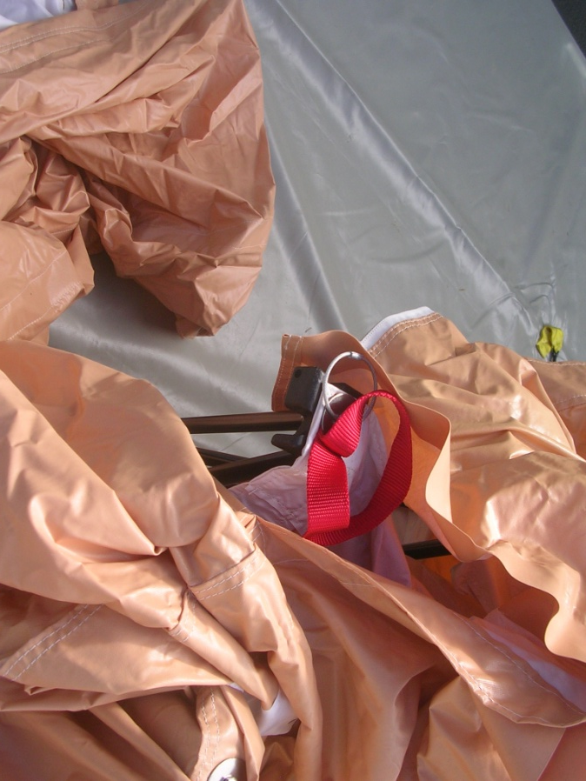
Insert lifting poles at both ends, have each person push up while other members clip outside corners to bottom tarp. Adding extra people to PUSH UP from inside helps considerably.

Slide 13
With tent raised, lock interior clips to yellow tabs on floor tarp & clip interior side tabs together.

Slide 14
Fully set up; note clips on floor tarp, curtains can pull back with velcro straps, windows also raise up or down with velcro.

Slide 15
To take down, station people at 4 corners, unclip interior & exterior clips, then gently glide tent and compress. Tent will collapse easily.

Slide 16
Compress all four corners to center, apply yellow belly band tightly.

Slide 17
Place dolly under exterior wrap first, then lift tent unit onto dolly.

Slide 18
Close up sides, using velcro to seal sides and top.

Slide 19
Close up exterior wrap, tighten black exterior straps.

Slide 20
Tighten exterior straps, insert lifting poles under straps.

Slide 21
Return to storage unit.

